Slide 1
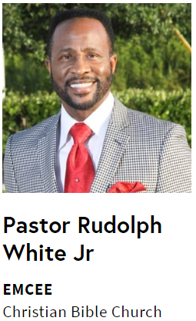
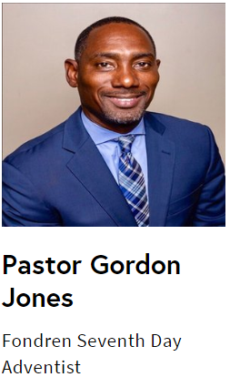
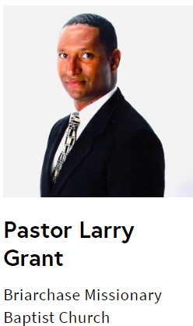
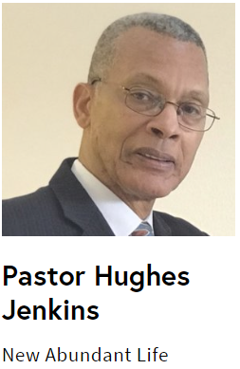
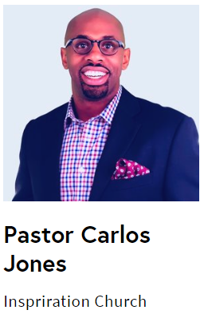
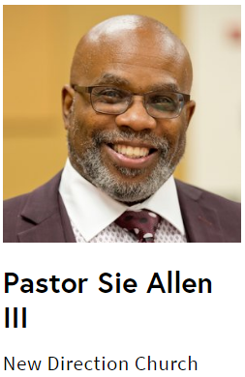
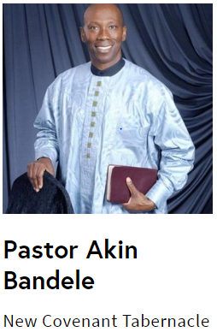
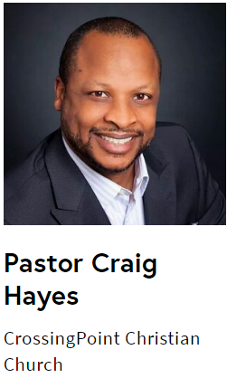
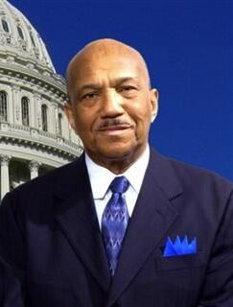
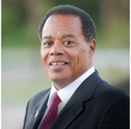
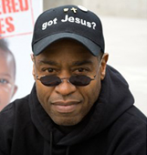
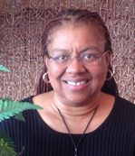
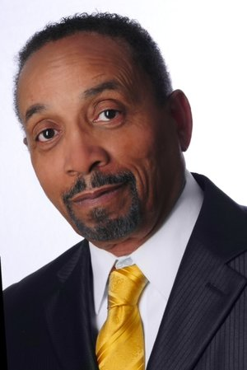
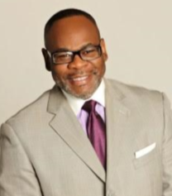
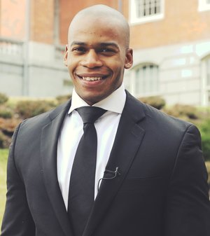
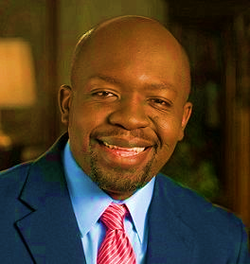
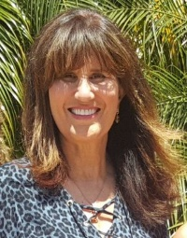
“Outstanding!”
“Mix of Cultures!”
“A Significant Shift!”
Dr. Rev. Martin Luther King, Jr. envisioned a world where we are judged by the content of our character, not by the color of our skin. This event presents our successes and hindrances in the achievement of that dream touching ALL AMERICANS through the lens of the American Black Experience. Dig deep into black history, social justice from a Biblical perspective, and the cultural information campaign designed to disrupt our Judeo-Christian values. Nationally recognized leaders from around the country are joining together to enlighten and broaden our perspectives. Experience this traveling
summit and be part of something bigger than what any one of us can do alone.
Fort Bend Houston Celebrates
Black History Month
Meet Rev. Bill Owens who Marched with Dr. Rev. Martin Luther King
Saturday, Feb 1, 2020
8:00am check-in | 8:30am-2:30pm Program | $35
“Phenomenal!”
Get Tickets! One Day Only
Pastor Stephen Broden Rev. Walter B. Hoye Lori Hoye Mason Weaver D L Foster Jonathan Alexandre Patrice Tsague Dran Reese
Get Tickets!
www.COCSHouston.com
Get Tickets! 888.725.8654
Office@SaltandLightCouncil.org

